Slide 1
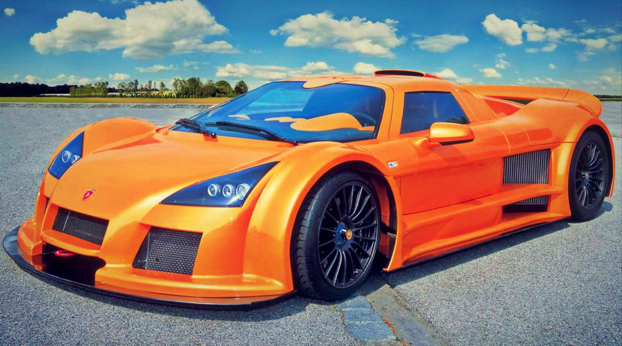
Accelerations in 1 and 2 Dimensions
Acceleration in 1 dimension
Units
Examples
Graphing Motion With Constant Acceleration
Position-time, velocity-time and acceleration-time
Constant Acceleration Equations
Examples
Acceleration in 2 dimensions
Examples

Slide 2
Acceleration
Acceleration is the rate of change of velocity
Velocity is a vector quantity therefore, acceleration is also a vector quantity
Average acceleration, a_{av}, is the change in velocity divided by the time interval for that change:
where v_{f} is the final velocity, v_{i} is the initial velocity, and Δt is the time interval.
Instantaneous acceleration is the acceleration any particular instant —but often just referred to as acceleration

Slide 3
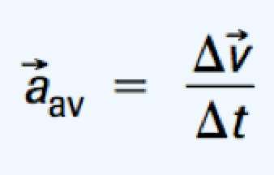
Acceleration Units
What units do you end up with for acceleration?
= m/s = m/s²
s
Acceleration is the change in velocity (m/s) over time (s) → m/s²

Slide 4
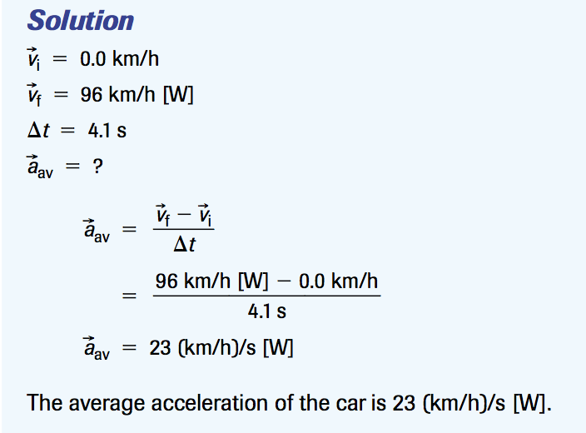
Example 1
A racing car accelerates from rest to 96 km/h [W] in 4.1 s. Determine the average acceleration of the car.

Slide 5
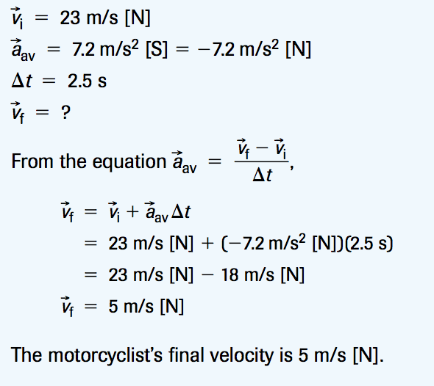
Example 2
A motorcyclist travelling at 23 m/s [N] applies the brakes, producing an average acceleration of 7.2 m/s² [S]. What is the motorcyclist’s velocity after 2.5 s?

Slide 6
Check Your Understanding
Is it possible to have acceleration when the velocity is zero? If “no,” explain.
Is it possible to have an eastward velocity with a westward acceleration? If “no,” explain why not. If “yes,” give an example.
A flock of robins is migrating southward. Describe the flock’s motion at instants when its acceleration is (a) positive, (b) negative, and (c) zero. Take the south- ward direction as positive.
A track runner, starting from rest, reaches a velocity of 9.3 m/s [fwd] in 3.9 s. Determine the runner’s average acceleration.
The Renault Espace is a production car that can go from rest to 26.7 m/s with an incredibly large average acceleration of magnitude 9.52 m/s2.
(a) How long does the Espace take to achieve its speed of 26.7 m/s?
(b) What is this speed in kilometres per hour?
The fastest of all fishes is the sailfish. If a sailfish accelerates at a rate of 14 (km/h)/s [fwd] for 4.7 s from its initial velocity of 42 km/h [fwd], what is its final velocity?
An arrow strikes a target in an archery tournament. The arrow undergoes an average acceleration of 1.37 x 10³ m/s² [W] in 3.12 x 10⁻² s then stops. Determine the velocity of the arrow when it hits the target.

Slide 7
Check Your Understanding Solutions
4. 2.4 m/s² [fwd]
5. (a) 2.80 s (b) 96.1km/h
6. 108 km/h [fwd]
7. 42.8 m/s [E]

Slide 8
What’s the cars average acceleration?
Lamborghini LP700-4 Aventador – Click Image

Slide 9
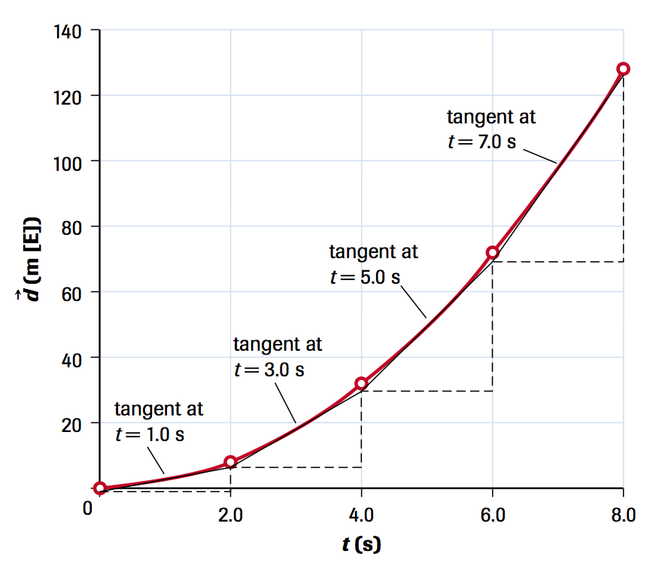
Graphing Motion with Constant Acceleration
A speedboat accelerates uniformly from rest for 8.0 s, with a displacement of 128 m [E] over that time interval. See the position-time graph below
The tangents represent the instantaneous velocities

Slide 10
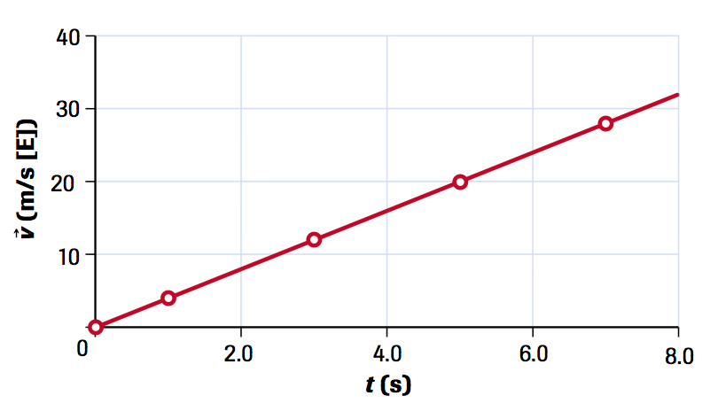
The velocity–time graph is on the right. It shows the instantaneous velocities as determined by the slopes of the tangents from the position-time graph (left)

Slide 11
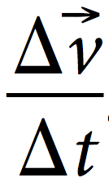
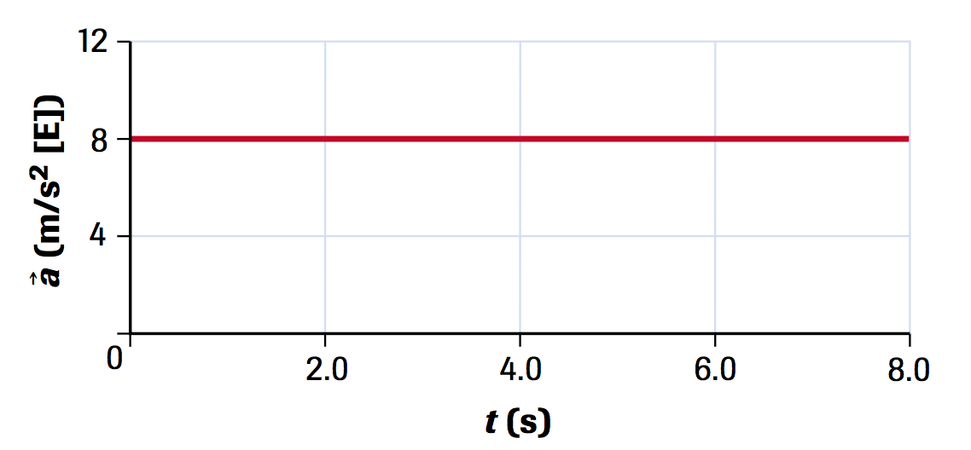
The acceleration can be determined from the slope of the line on the velocity-time which is
In this example, the slope, and thus the acceleration, is 8.0m/s² [E].

Slide 12
P-T, V-T and A-T Graphs

Slide 13
What the graphs tell us
The area under the line on a velocity-time graph indicates the change in position over the time interval
The area under the line on an acceleration-time graph indicates the change in velocity over the time interval

Slide 14
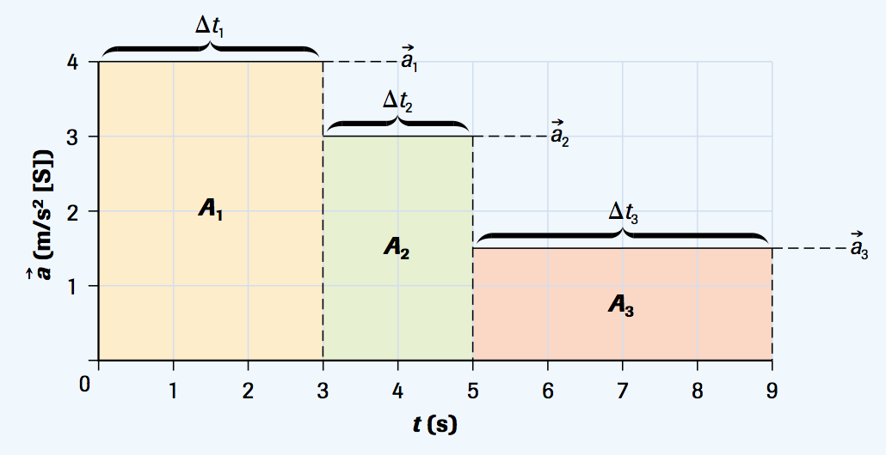
Check Your Understanding
This is the acceleration-time graph of a car accelerating through its first three gears. Assume that the initial velocity is zero.
(a) Use the information in the graph to determine the final velocity in each gear. Draw the corresponding velocity-time graph.
(b) From the velocity time graph, determine the car’s displacement from its initial position after 5.0 s.

Slide 15
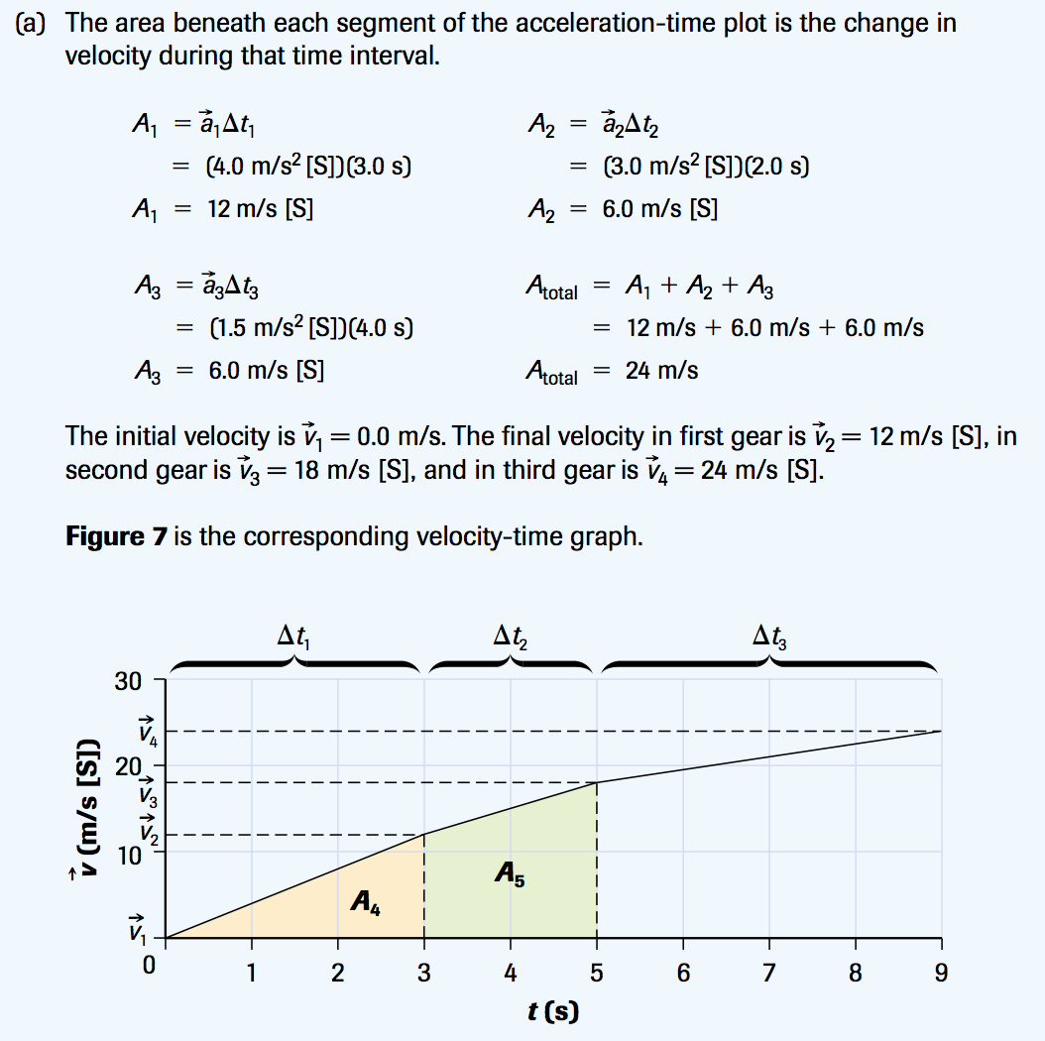
Check Your Understanding - Solutions

Slide 16
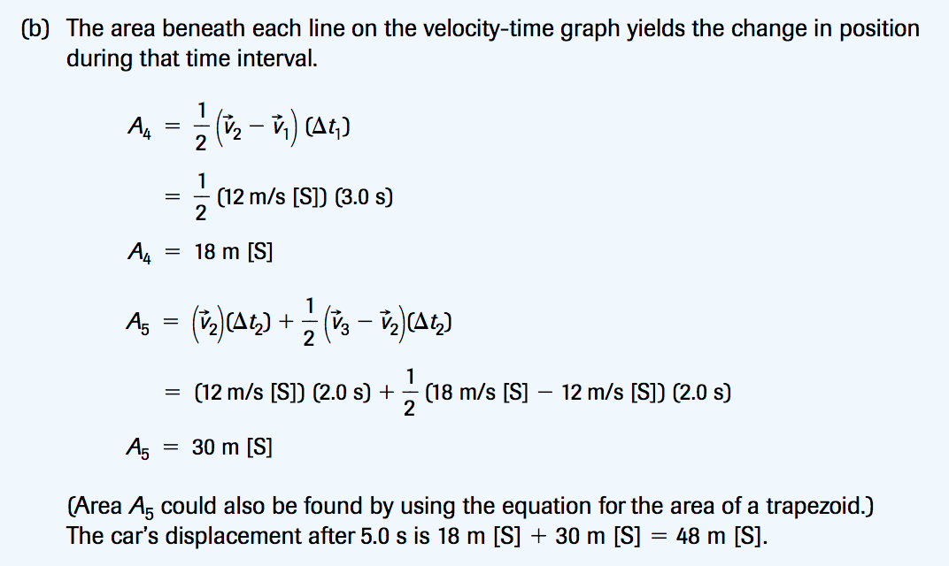
Check Your Understanding Solutions

Slide 17
Check Your Understanding
1. This chart summarizes observations of a crawling baby experiencing constant acceleration over several successive 2.0-s intervals.
(a) Draw a velocity-time graph for this motion.
(b) Use the information on your velocity-time graph to draw the corresponding acceleration-time graph.
Time (s) | Velocity
0 | 10
2 | 15
4 | 20
6 | 15
8 | 10
10 | 5

Slide 18
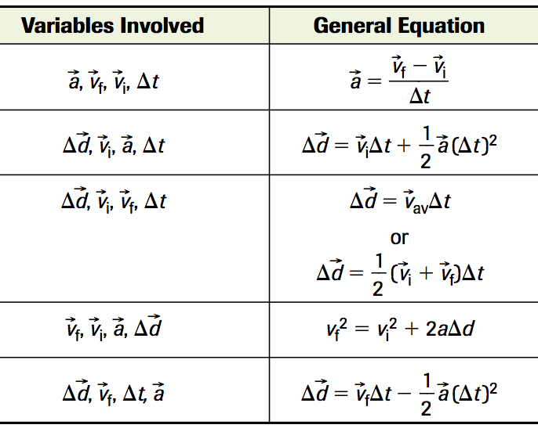
Constant Acceleration Equations
Use these equations to solve motion problems involving acceleration, displacement, time and velocity.

Slide 19
Solving Equations
Whenever you are faced with a word problem the first thing you need to do is determine what is given and what unknown including all units. By doing this you will prevent a lot of mistakes.

Slide 20
Check Your Understanding
A motorcyclist, travelling initially at 12 m/s [W], changes gears and speeds up for 3.5 s with a constant acceleration of 5.1 m/s2 [W]. What is the motorcyclist’s displacement over this time interval?
1) Determine your Given(s) and Unknown(s)

Slide 21
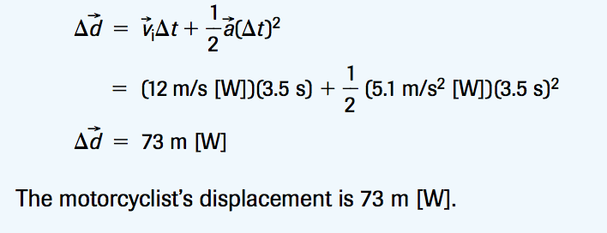
Check Your Understanding
A motorcyclist, travelling initially at 12 m/s [W], changes gears and speeds up for 3.5 s with a constant acceleration of 5.1 m/s2 [W]. What is the motorcyclist’s displacement over this time interval?
2) Solve and write your concluding statement

Slide 22
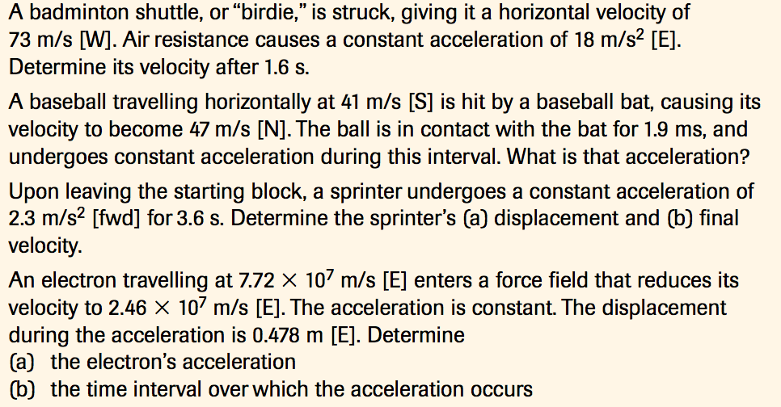
Practice
1.
2.
3.
4.

Slide 23
Practice - Answers
44 m/s [W]
4.6 x 10⁴ m/s² [N]
a) 15 m [fwd] b) 8.3 m/s[fwd]
5.60 x 10¹⁵ m/s² [W] b) 9.39x10⁻⁹ s

Slide 24
Acceleration in 2 dimensions
Acceleration in two dimensions occurs when the velocity of an object moving in a plane undergoes a change in magnitude, or a change in direction, or a simultaneous change in both magnitude and direction.
The same equations apply and since it involves vector subtraction, the equations can also be applied to the components of vectors.

Slide 25
Check Your Understanding
A car with a velocity of 25 m/s [E] changes its velocity to 25 m/s [S] in 15 s. Calculate the car’s average acceleration.
A watercraft with an initial velocity of 6.4 m/s [E] undergoes an average acceleration of 2.0 m/s² [S] for 2.5 s. What is the final velocity of the watercraft?

Slide 26
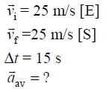
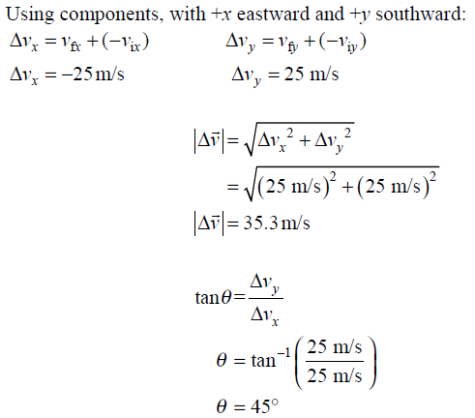
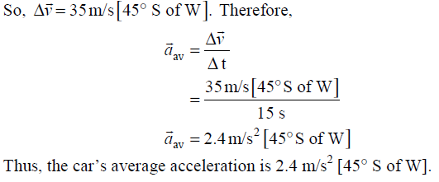
Check Your Understanding Answers
1.

Slide 27
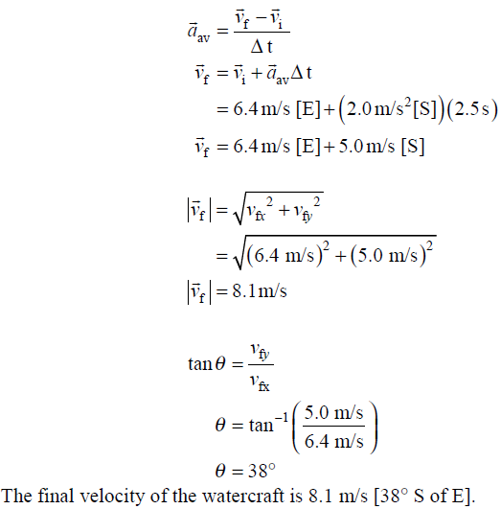
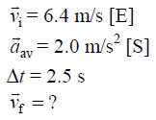
Check Your Understanding Answers
2.

